Slide 1
TrailBuddy
Devika Mittal, Nayeli Zurita, Kai Nguyen, Mary Zeno, Johanna Johnsen, Prapti Singh

Slide 2
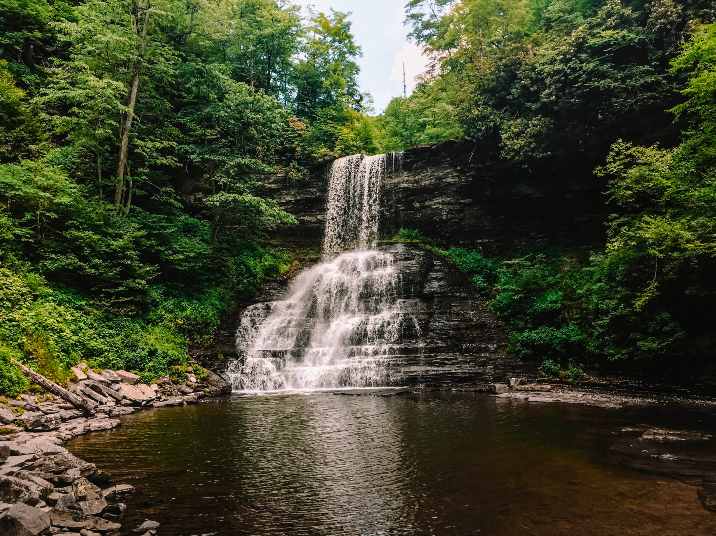
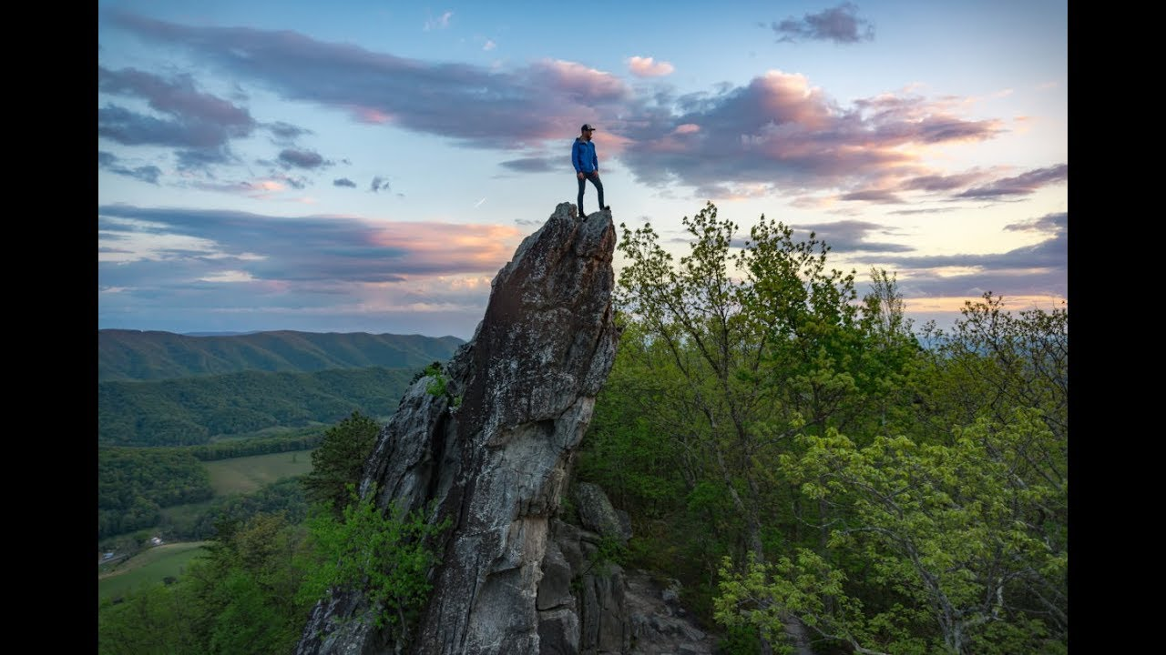
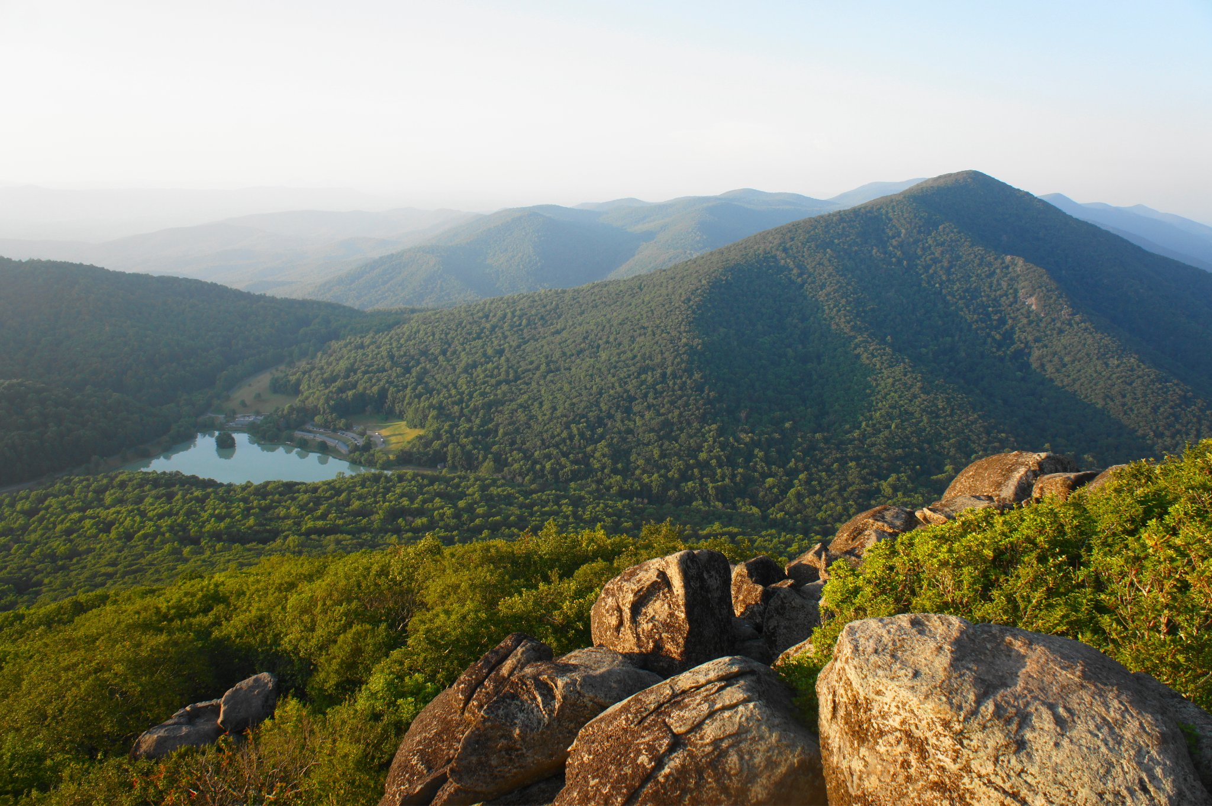
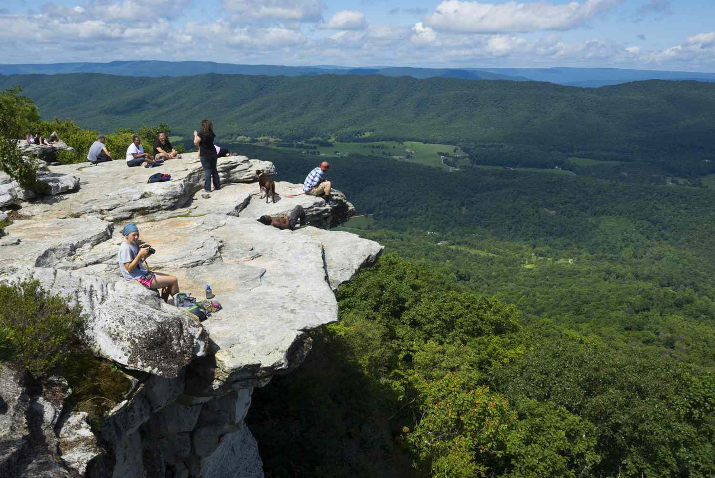
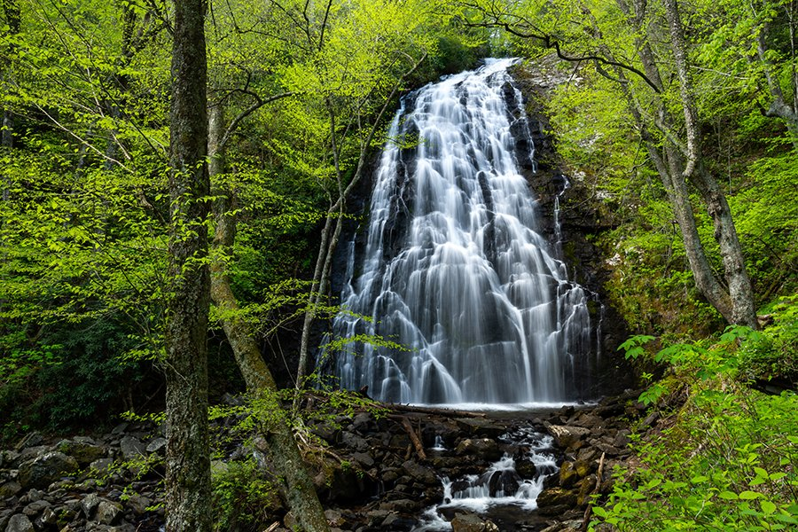
Introduction
TrailBuddy makes hiking for beginners safer and easier!
Help students and young adults discover the natural wonders the New River and Blue ridge mountains has to offer in a safe group

Slide 3


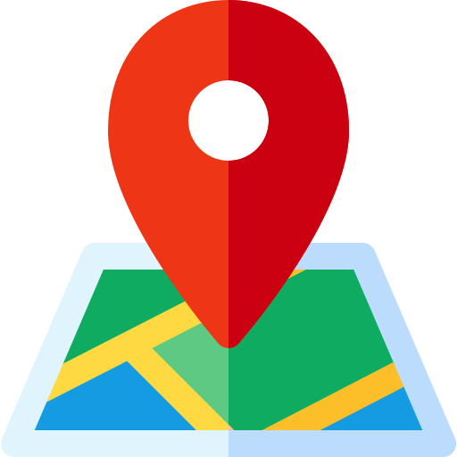

Features: Informational
Trail information
Trail hazards
Weather concerns
Gear recommendations
Map
Directions
Trail recommendations
Trail popularity
Filtering based on criteria
Events near trails
Personal health stats
Notes:
Kai

Slide 4






Features: Social
- Creation/management of discussion threads
- User participation in forum discussions
- User rankings/badges
- Sending friend/group join requests.
- Notification system
for requests.
- User registration/login
- User info storage
- Privacy settings for profile information
Personal Profile
Friend/group request feature
Forum / Chat
- Calendar view for events.
- Event invitation system
- Notifications for scheduled events.
More non-functional requirements:
- User data protection
- User-friendly design
- Disaster recovery
- Algorithm or criteria for suggesting friends
- Matching process based on filtering user preferences
Scalability (non-functional)
Scheduler
Friend match
Notes:
Johanna

Slide 5
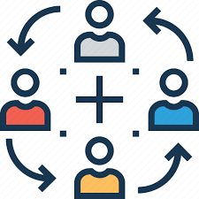

Responsibilities
Informational Team: Devika, Nayeli, and Mary
Social Team: Kai, Johanna, and Prapti
Notes:
Mary
In order to ensure everyone does an equal share of responsibility for this project we have split up our group into two teams. A social and informational team. Our social team will have Kai, Johanna and Prapti. The informational team has devika, nayeli and mary. On each team, each member has 2 to 4 features to work on depending on how extenuating each feature is. They are in charge of the feature’s documentation, design, and implementation. On our social team, Kai is responsible for personal profile and scalability features. Johanna is in charge of the forum and scheduler. While Prapti is responsible for the friend group request feature. On the other hand, for our informational team, Devika is in charge of trail information, hazards, weather concerns and gear recommendations. Nayeli is in charge of maps, directions, trail recommendations and trail popularity. Lastly Mary is in charge of the filtering system, events near trails and personal health stats.

Slide 6
Challenges + Strategies
Limited Domain Knowledge
Data collection and Maintenance
Complex algorithms for matching buddies
User privacy
User engagement and retention
User safety
Collaborate with local hiking groups, local hiking events, outdoor clubs, etc.
Automate data collection and use of APIs
Research existing algorithms
Implementing strict privacy controls
User-friendly design and implement gamification elements
Educating the users
Notes:
Prapti

